Slide 1
Data Mining:
Concepts and Techniques
Data Mining: Concepts and Techniques

Slide 2
Concept Description, Mining Frequent Patterns, Associations and Correlations
What is concept description?
Data generalization and summarization-based characterization
Analytical characterization: Analysis of attribute relevance
Mining class comparisons: Discriminating between different classes
Association rule mining
Mining single-dimensional Boolean association rules from transactional databases
From association mining to correlation analysis
Constraint-based association mining
Summary
Data Mining: Concepts and Techniques

Slide 3
What is Concept Description?
Descriptive vs. predictive data mining (DM task categories)
  Descriptive mining: describes concepts or task-relevant data sets in concise, summarative, informative, discriminative forms
  Predictive mining: Based on data and analysis, constructs models for the database, and predicts the trend and properties of unknown data
Concept description:
  Characterization: provides a concise summarization of the given collection of data
  Comparison: provides descriptions comparing two or more collections of data

Slide 4
Concept Description vs. OLAP
Concept description:
  can handle complex data types of the attributes and their aggregations
  a more automated process
OLAP:
  restricted to a small number of dimension and measure types
  user-controlled process
Data Mining: Concepts and Techniques

Slide 5
Concept Description, Mining Frequent Patterns, Associations and Correlations
What is concept description?
Data generalization and summarization-based characterization
Analytical characterization: Analysis of attribute relevance
Mining class comparisons: Discriminating between different classes
Association rule mining
Mining single-dimensional Boolean association rules from transactional databases
From association mining to correlation analysis
Constraint-based association mining
Summary
Data Mining: Concepts and Techniques

Slide 6
Data Generalization and Summarization-based Characterization
Data generalization
  A process which abstracts a large set of task-relevant data in a database from a low conceptual levels to higher ones.
  Approaches:
    Data cube approach(OLAP approach)
    Attribute-oriented induction approach
1
2
3
4
Conceptual levels
5
Data Mining: Concepts and Techniques

Slide 7
Characterization: Data Cube Approach
Data are stored in data cube
Identify expensive computations
  e.g., count( ), sum( ), average( ), max( )
Perform computations and store results in data cubes
Generalization and specialization can be performed on a data cube by roll-up and drill-down
An efficient implementation of data generalization
Data Mining: Concepts and Techniques

Slide 8
Data Cube Approach (Cont…)
Limitations
  can only handle data types of dimensions to simple nonnumeric data and of measures to simple aggregated numeric values.
  Lack of intelligent analysis, can’t tell which dimensions should be used and what levels should the generalization reach
Data Mining: Concepts and Techniques

Slide 9
Attribute-Oriented Induction
Proposed in 1989 (KDD ‘89 workshop)
Not confined to categorical data nor particular measures.
How it is done?
  Collect the task-relevant data (initial relation) using a relational database query
  Perform generalization by attribute removal or attribute generalization.
  Apply aggregation by merging identical, generalized tuples and accumulating their respective counts
  Interactive presentation with users
Data Mining: Concepts and Techniques

Slide 10
Concept Description, Mining Frequent Patterns, Associations and Correlations
What is concept description?
Data generalization and summarization-based characterization
Analytical characterization: Analysis of attribute relevance
Mining class comparisons: Discriminating between different classes
Association rule mining
Mining single-dimensional Boolean association rules from transactional databases
From association mining to correlation analysis
Constraint-based association mining
Summary
Data Mining: Concepts and Techniques

Slide 11
Characterization vs. OLAP
Similarity:
  Presentation of data summarization at multiple levels of abstraction.
  Interactive drilling, pivoting, slicing and dicing.
Differences:
  Automated desired level allocation.
  Dimension relevance analysis and ranking when there are many relevant dimensions.
  Sophisticated typing on dimensions and measures.
  Analytical characterization: data dispersion analysis.
  (distribution)
Data Mining: Concepts and Techniques

Slide 12
Attribute Relevance Analysis
Why?
  Which dimensions should be included?
  How high level of generalization?
  Automatic VS. Interactive
  Reduce # attributes; Easy to understand patterns
What?
  statistical method for preprocessing data
    filter out irrelevant or weakly relevant attributes
    retain or rank the relevant attributes
  relevance related to dimensions and levels
  analytical characterization, analytical comparison
Data Mining: Concepts and Techniques

Slide 13
Attribute relevance analysis (cont’d)
How?
  Data Collection
  Analytical Generalization
    Use information gain analysis (e.g., entropy or other measures) to identify highly relevant dimensions and levels.
  Relevance Analysis
    Sort and select the most relevant dimensions and levels.
  Attribute-oriented Induction for class description
    On selected dimension/level
  OLAP operations (e.g. drilling, slicing) on relevance rules
Data Mining: Concepts and Techniques

Slide 14
Relevance Measures
Quantitative relevance measure determines the classifying power of an attribute within a set of data.
Methods
  information gain (ID3)
  gain ratio (C4.5)
  gini index
  χ² contingency table statistics
  uncertainty coefficient
Data Mining: Concepts and Techniques

Slide 15
Information-Theoretic Approach
Decision tree
  each internal node tests an attribute
  each branch corresponds to attribute value
  each leaf node assigns a classification
ID3 algorithm
  build decision tree based on training objects with known class labels to classify testing objects
  rank attributes with information gain measure
  minimal height
    the least number of tests to classify an object
Data Mining: Concepts and Techniques

Slide 16
Top-Down Induction of Decision Tree
Attributes = {Outlook, Temperature, Humidity, Wind}
PlayTennis = {yes, no}
Outlook
sunny
rain
overcast
Humidity
Wind
yes
high
normal
strong
weak
no
yes
no
yes
Data Mining: Concepts and Techniques

Slide 17
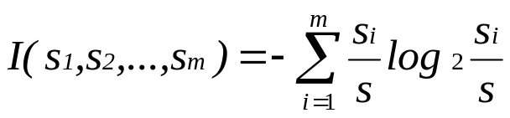
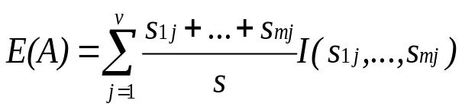

Entropy and Information Gain
S contains s_{i} tuples of class C_{i} for i = {1, …, m}
Information measures info required to classify any arbitrary tuple
Entropy of attribute A with values {a₁,a₂,…,a_{v}}
Information gained by branching on attribute A
Data Mining: Concepts and Techniques

Slide 18
Example: Analytical Characterization
Task
  Mine general characteristics describing graduate students using analytical characterization
Given
  attributes name, gender, major, birth_place, birth_date, phone#, and gpa
  Gen(a_{i}) = concept hierarchies on a_{i}
  U_{i} = attribute analytical thresholds for a_{i}
  T_{i} = attribute generalization thresholds for a_{i}
  R = attribute relevance threshold
Data Mining: Concepts and Techniques

Slide 19
Example: Analytical Characterization (cont’d)
1. Data collection
  target class: graduate student
  contrasting class: undergraduate student
2. Analytical generalization using U_{i}
  attribute removal
    remove name and phone#
  attribute generalization
    generalize major, birth_place, birth_date and gpa
    accumulate counts
  candidate relation: gender, major, birth_country, age_range and gpa
Data Mining: Concepts and Techniques

Slide 20
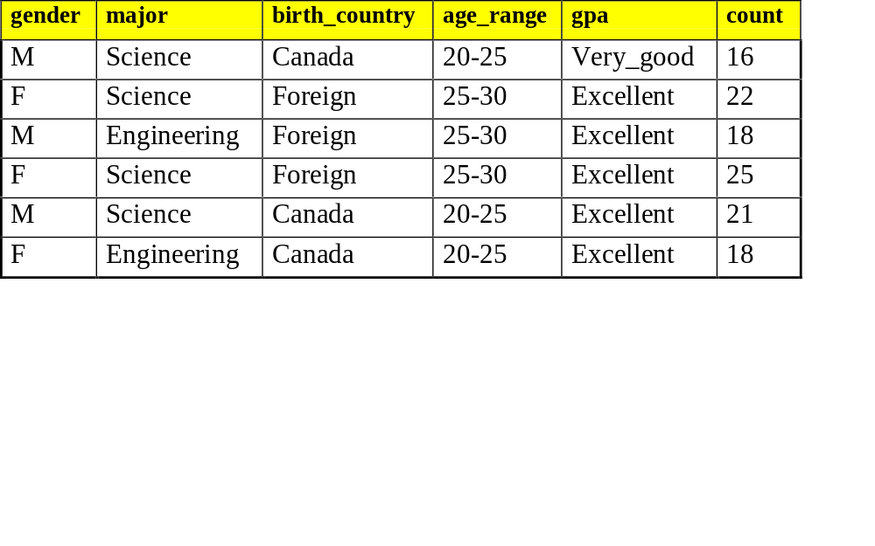
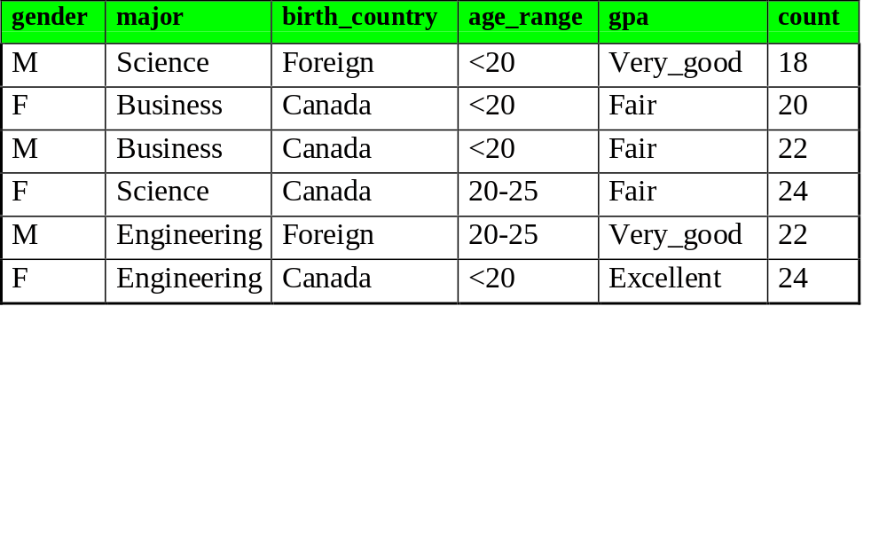
Example: Analytical characterization (2)
Candidate relation for Target class: Graduate students (Σ=120)
Candidate relation for Contrasting class: Undergraduate students (Σ=130)
Data Mining: Concepts and Techniques

Slide 21
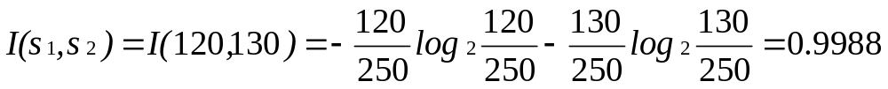
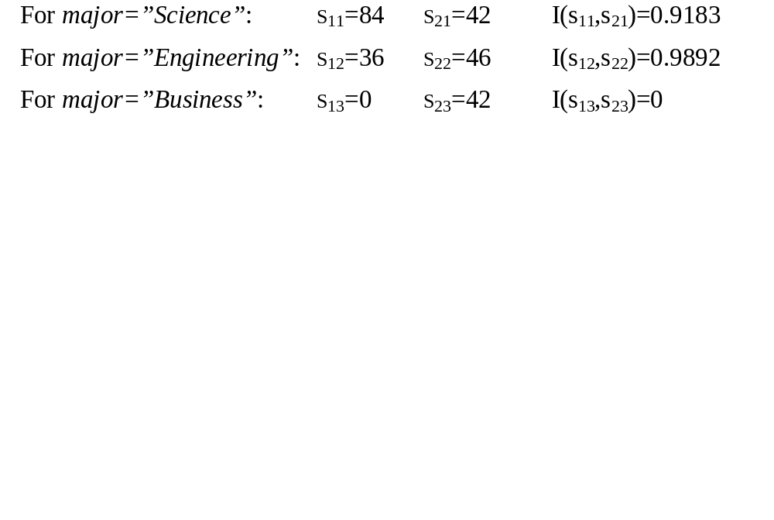
Example: Analytical characterization (3)
3. Relevance analysis
  Calculate expected info required to classify an arbitrary tuple
  Calculate entropy of each attribute: e.g. major
Number of grad students in “Science”
Number of undergrad students in “Science”
Data Mining: Concepts and Techniques

Slide 22
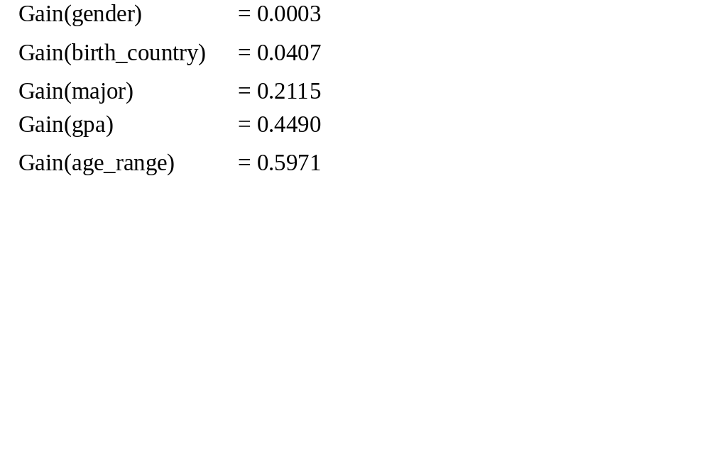
Example: Analytical Characterization (4)
Calculate expected info required to classify a given sample if S is partitioned according to the attribute
Calculate information gain for each attribute
  Information gain for all attributes
Data Mining: Concepts and Techniques

Slide 23
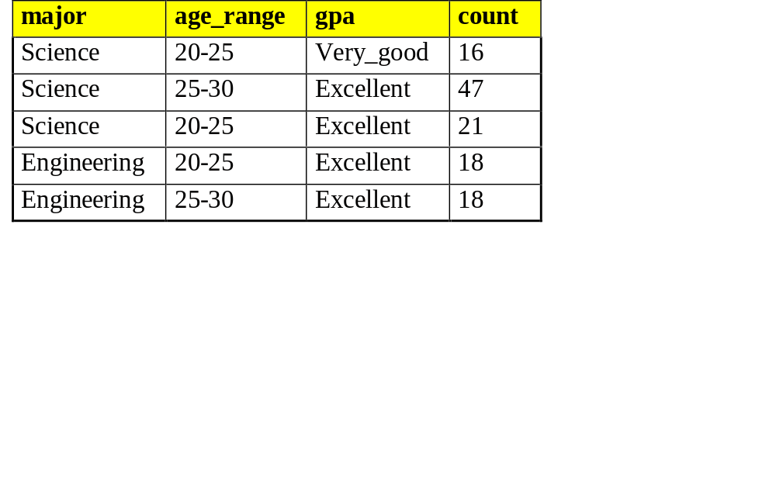
Example: Analytical characterization (5)
4. Initial working relation (W₀) derivation
  R = 0.1
  remove irrelevant/weakly relevant attributes from candidate relation => drop gender, birth_country
  remove contrasting class candidate relation
5. Perform attribute-oriented induction on W₀ using T_{i}
Initial target class working relation W₀: Graduate students
Data Mining: Concepts and Techniques

Slide 24
Concept Description, Mining Frequent Patterns, Associations and Correlations
What is concept description?
Data generalization and summarization-based characterization
Analytical characterization: Analysis of attribute relevance
Mining class comparisons: Discriminating between different classes
Association rule mining
Mining single-dimensional Boolean association rules from transactional databases
From association mining to correlation analysis
Constraint-based association mining
Summary
Data Mining: Concepts and Techniques

Slide 25
Mining Class Comparisons
Comparison: Comparing two or more classes.
Method:
  Partition the set of relevant data into the target class and the contrasting class(es)
  Generalize both classes to the same high level concepts
  Compare tuples with the same high level descriptions
  Present for every tuple its description and two measures:
    support - distribution within single class
    comparison - distribution between classes
  Highlight the tuples with strong discriminant features
Relevance Analysis:
  Find attributes (features) which best distinguish different classes.

Slide 26
Example: Analytical comparison
Task
  Compare graduate and undergraduate students using discriminant rule.
  DMQL query
use Big_University_DB
mine comparison as “grad_vs_undergrad_students”
in relevance to name, gender, major, birth_place, birth_date, residence, phone#, gpa
for “graduate_students”
where status in “graduate”
versus “undergraduate_students”
where status in “undergraduate”
analyze count%
from student
Data Mining: Concepts and Techniques

Slide 27
Example: Analytical comparison (2)
Given
  attributes name, gender, major, birth_place, birth_date, residence, phone# and gpa
  Gen(a_{i}) = concept hierarchies on attributes a_{i}
  U_{i} = attribute analytical thresholds for attributes a_{i}
  T_{i} = attribute generalization thresholds for attributes a_{i}
  R = attribute relevance threshold
Data Mining: Concepts and Techniques

Slide 28
Example: Analytical comparison (3)
1. Data collection
  target and contrasting classes
2. Attribute relevance analysis
  remove attributes name, gender, major, phone# (based on user/expert specified dim. thresholds)
3. Synchronous generalization
  controlled by user-specified dimension thresholds
  prime target and contrasting class(es) relations/cuboids
Data Mining: Concepts and Techniques

Slide 29
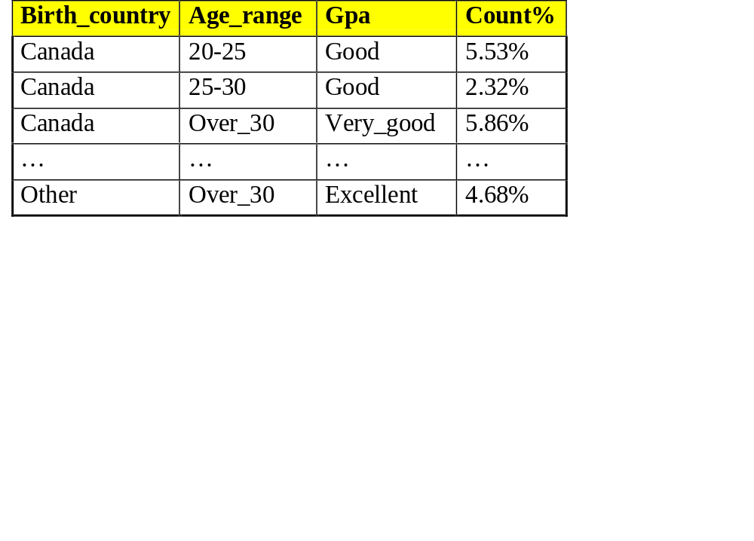
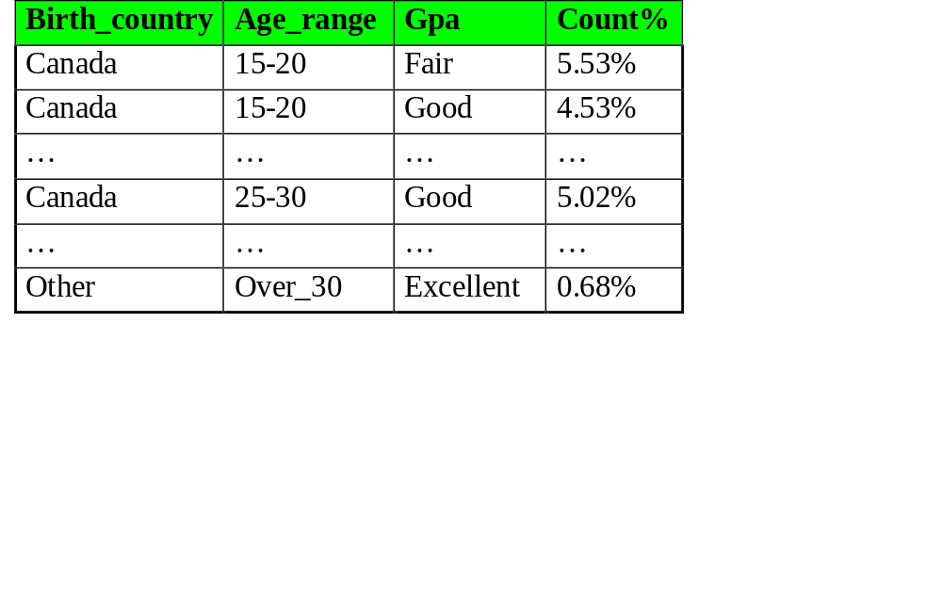
Example: Analytical comparison (4)
Prime generalized relation for the target class: Graduate students
Prime generalized relation for the contrasting class: Undergraduate students
Data Mining: Concepts and Techniques

Slide 30
Example: Analytical comparison (5)
4. Drill down, roll up and other OLAP operations on target and contrasting classes to adjust levels of abstractions of resulting description
5. Presentation
  as generalized relations, crosstabs, bar charts, pie charts, or rules
  contrasting measures to reflect comparison between target and contrasting classes
    e.g. count%
Data Mining: Concepts and Techniques

Slide 31
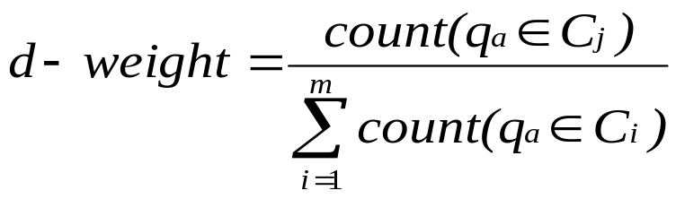
Quantitative Discriminant Rules
Cj = target class
q_{a} = a generalized tuple covers some tuples of class
  but can also cover some tuples of contrasting class
d-weight
  range: [0, 1]
quantitative discriminant rule form
Data Mining: Concepts and Techniques

Slide 32
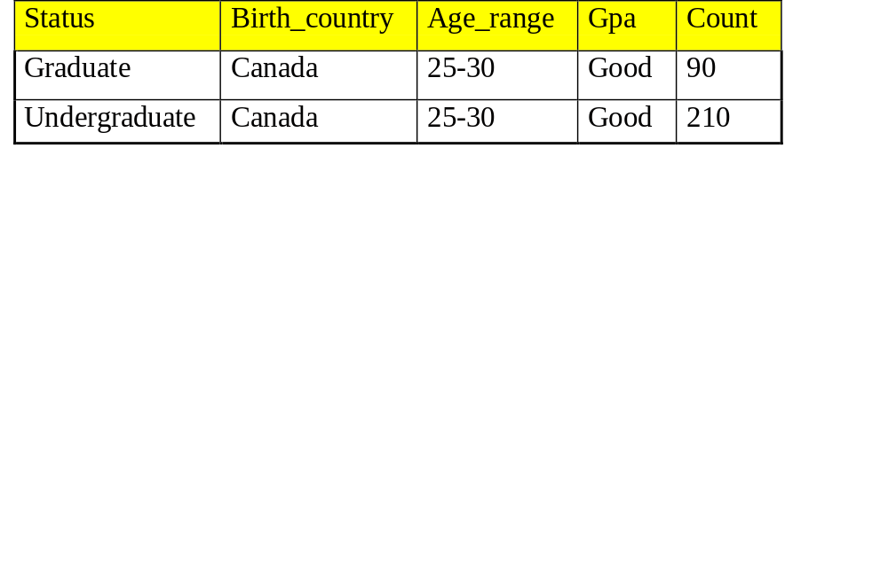
Example: Quantitative Discriminant Rule
Count distribution between graduate and undergraduate students for a generalized tuple
Quantitative discriminant rule
  where 90/(90+210) = 30%
Data Mining: Concepts and Techniques

Slide 33
Concept Description, Mining Frequent Patterns, Associations and Correlations
What is concept description?
Data generalization and summarization-based characterization
Analytical characterization: Analysis of attribute relevance
Mining class comparisons: Discriminating between different classes
Association rule mining
Mining single-dimensional Boolean association rules from transactional databases
From association mining to correlation analysis
Constraint-based association mining
Summary
Data Mining: Concepts and Techniques

Slide 34
Introduction
Frequent patterns: appear in dataset frequently
  Set of items that appear frequently together in a transaction data set is a frequent itemset. (milk-bread, bread-butter)
  If a subsequence occurs frequently in a history database, is a frequent sequential pattern. (buying a PC then digital camera then memory card)
  If a substructure occurs frequently, it is called a frequent structured pattern.
Finding such frequent patterns plays an important role in mining associations, correlations and other interesting relationships among data.
Data Mining: Concepts and Techniques

Slide 35
What Is Association Mining?
Association rule mining:
  Finding frequent patterns, associations, correlations, or causal structures among sets of items or objects in transaction databases, relational databases, and other information repositories.
Applications:
  Basket data analysis, cross-marketing, catalog design, loss-leader analysis, clustering, classification, etc.
Examples.
  Rule form: “Body → Ηead [support, confidence]”.
  buys(x, “diapers”) → buys(x, “beers”) [0.5%, 60%] (i.e. 0.5% of all transactions under analysis show that diapers and beers are bought together. 60% of customer who bought diapers also bought beers.)
  major(x, “CS”) ^ takes(x, “DB”) → grade(x, “A”) [1%, 75%]
Data Mining: Concepts and Techniques

Slide 36
Association Rule: Basic Concepts
Given: (1) database of transactions, (2) each transaction is a list of items (purchased by a customer in a visit)
Find: all rules that correlate the presence of one set of items with that of another set of items
  E.g., 98% of people who purchase tires and auto accessories also get automotive services done
Applications
  * ⇒ Maintenance Agreement (What the store should do to boost Maintenance Agreement sales)
  Home Electronics ⇒ * (What other products should the store stocks up?)
  Attached mailing in direct marketing
  Detecting “ping-pong”ing of patients, faulty “collisions”
Data Mining: Concepts and Techniques

Slide 37
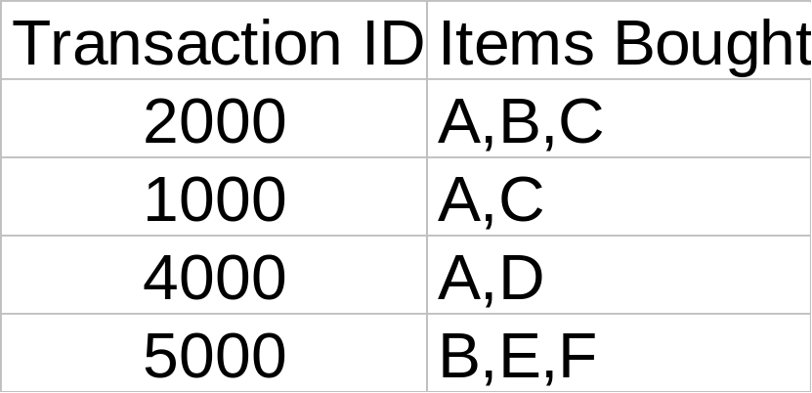
Rule Measures: Support and Confidence
Customer
buys both
Customer
buys diaper
Find all the rules X & Y ⇒ Z with minimum confidence and support
  support, s, probability that a transaction contains {X  Y  Z}
  confidence, c, conditional probability that a transaction having {X  Y} also contains Z
Customer
buys beer
Let minimum support 50%, and minimum confidence 50%, we have
  A ⇒ C (50%, 66.6%)
  C ⇒ A (50%, 100%)
Data Mining: Concepts and Techniques

Slide 38
Association Rule Mining: A Road Map
Boolean vs. quantitative associations (Based on the types of values handled)
  buys(x, “SQLServer”) ^ buys(x, “DMBook”) → buys(x, “DBMiner”) [0.2%, 60%]
  age(x, “30..39”) ^ income(x, “42..48K”) → buys(x, “PC”) [1%, 75%]
Single dimension vs. multiple dimensional associations (see ex. Above)
Single level vs. multiple-level analysis
  What brands of beers are associated with what brands of diapers?
Various extensions
  Correlation, causality analysis
    Association does not necessarily imply correlation or causality
  Maxpatterns and closed itemsets
  Constraints enforced
    E.g., small sales (sum < 100) trigger big buys (sum > 1,000)?
Data Mining: Concepts and Techniques

Slide 39
Concept Description, Mining Frequent Patterns, Associations and Correlations
What is concept description?
Data generalization and summarization-based characterization
Analytical characterization: Analysis of attribute relevance
Mining class comparisons: Discriminating between different classes
Association rule mining
Mining single-dimensional Boolean association rules from transactional databases
From association mining to correlation analysis
Constraint-based association mining
Summary
Data Mining: Concepts and Techniques

Slide 40
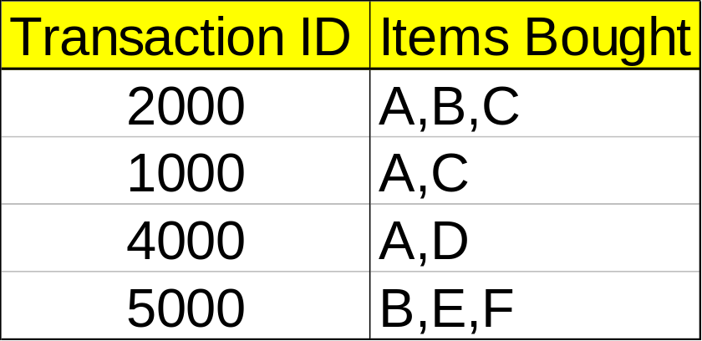
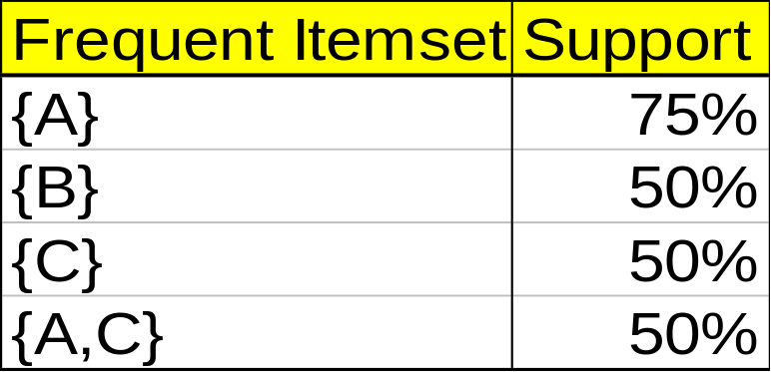
Mining Association Rules—An Example
Min. support 50%
Min. confidence 50%
For rule A ⇒ C:
  support = support({A C}) = 50%
  confidence = support({A C})/support({A}) = 66.6%
The Apriori principle:
  Any subset of a frequent itemset must be frequent
Data Mining: Concepts and Techniques

Slide 41
Mining Frequent Itemsets: the Key Step
Find the frequent itemsets: the sets of items that have minimum support
  A subset of a frequent itemset must also be a frequent itemset
    i.e., if {AB} is a frequent itemset, both {A} and {B} should be a frequent itemset
  Iteratively find frequent itemsets with cardinality from 1 to k (k-itemset)
Use the frequent itemsets to generate association rules.
Data Mining: Concepts and Techniques

Slide 42
The Apriori Algorithm
Join Step: C_{k} is generated by joining L_{k-1}with itself
Prune Step: Any (k-1)-itemset that is not frequent cannot be a subset of a frequent k-itemset
Pseudo-code:
    C_{k}: Candidate itemset of size k
    L_{k} : frequent itemset of size k
    L₁ = {frequent items};
    for (k = 1; L_{k} !=∅; k++) do begin
    C_{k+1} = candidates generated from L_{k};
    for each transaction t in database do
      increment the count of all candidates in C_{k+1} that are contained in t
    L_{k+1} = candidates in C_{k+1} with min_support
    end
    return ∪_{k} L_{k};
Data Mining: Concepts and Techniques

Slide 43








The Apriori Algorithm — Example
Database D
L₁
C₁
Scan D
C₂
C₂
L₂
Scan D
C₃
Scan D
L₃
Data Mining: Concepts and Techniques

Slide 44
How to Generate Candidates?
Suppose the items in L_{k-1} are listed in an order
Step 1: self-joining L_{k-1}
  insert into C_{k}
  select p.item₁, p.item₂, …, p.item_{k-1}, q.item_{k-1}
  from L_{k-1} p, L_{k-1} q
  where p.item₁=q.item₁, …, p.item_{k-2}=q.item_{k-2}, p.item_{k-1} < q.item_{k-1}
Step 2: pruning
  forall itemsets c in C_{k} do
    forall (k-1)-subsets s of c do
      if (s is not in L_{k-1}) then delete c from C_{k}
Data Mining: Concepts and Techniques

Slide 45
How to Count Supports of Candidates?
Why counting supports of candidates a problem?
  The total number of candidates can be very huge
  One transaction may contain many candidates
Method:
  Candidate itemsets are stored in a hash-tree
  Leaf node of hash-tree contains a list of itemsets and counts
  Interior node contains a hash table
  Subset function: finds all the candidates contained in a transaction
Data Mining: Concepts and Techniques

Slide 46
Example of Generating Candidates
L₃={abc, abd, acd, ace, bcd}
Self-joining: L₃*L₃
  abcd from abc and abd
  acde from acd and ace
Pruning:
  acde is removed because ade is not in L₃
C₄={abcd}
Data Mining: Concepts and Techniques

Slide 47
Methods to Improve Apriori’s Efficiency
Hash-based itemset counting: A k-itemset whose corresponding hashing bucket count is below the threshold cannot be frequent
Transaction reduction: A transaction that does not contain any frequent k-itemset is useless in subsequent scans
Partitioning: Any itemset that is potentially frequent in DB must be frequent in at least one of the partitions of DB
Sampling: mining on a subset of given data, lower support threshold + a method to determine the completeness
Dynamic itemset counting: add new candidate itemsets only when all of their subsets are estimated to be frequent
Data Mining: Concepts and Techniques

Slide 48
Is Apriori Fast Enough? — Performance Bottlenecks
The core of the Apriori algorithm:
  Use frequent (k – 1)-itemsets to generate candidate frequent k-itemsets
  Use database scan and pattern matching to collect counts for the candidate itemsets
The bottleneck of Apriori: candidate generation
  Huge candidate sets:
    10⁴ frequent 1-itemset will generate 10⁷ candidate 2-itemsets
    To discover a frequent pattern of size 100, e.g., {a₁, a₂, …, a₁₀₀}, one needs to generate 2¹⁰⁰ ≈ 10³⁰ candidates.
  Multiple scans of database:
    Needs (n +1 ) scans, n is the length of the longest pattern
Data Mining: Concepts and Techniques

Slide 49
Mining Frequent Patterns Without Candidate Generation
Compress a large database into a compact, Frequent-Pattern tree (FP-tree) structure
  highly condensed, but complete for frequent pattern mining
  avoid costly database scans
Develop an efficient, FP-tree-based frequent pattern mining method
  A divide-and-conquer methodology: decompose mining tasks into smaller ones
  Avoid candidate generation: sub-database test only!
Data Mining: Concepts and Techniques

Slide 50
Construct FP-tree from a Transaction DB
TID Items bought (ordered) frequent items
100 {f, a, c, d, g, i, m, p} {f, c, a, m, p}
200 {a, b, c, f, l, m, o} {f, c, a, b, m}
300 {b, f, h, j, o} {f, b}
400 {b, c, k, s, p} {c, b, p}
500 {a, f, c, e, l, p, m, n} {f, c, a, m, p}
min_support = 0.5
{}
Steps:
Scan DB once, find frequent 1-itemset (single item pattern)
Order frequent items in frequency descending order
Scan DB again, construct FP-tree
Header Table
Item frequency head
f 4
c 4
a 3
b 3
m 3
p 3
f:4
c:1
c:3
b:1
b:1
a:3
p:1
m:2
b:1
Data Mining: Concepts and Techniques
p:2
m:1

Slide 51
Benefits of the FP-tree Structure
Completeness:
  never breaks a long pattern of any transaction
  preserves complete information for frequent pattern mining
Compactness
  reduce irrelevant information—infrequent items are gone
  frequency descending ordering: more frequent items are more likely to be shared
  never be larger than the original database (if not count node-links and counts)
  Example: For Connect-4 DB, compression ratio could be over 100
Data Mining: Concepts and Techniques

Slide 52
Mining Frequent Patterns Using FP-tree
General idea (divide-and-conquer)
  Recursively grow frequent pattern path using the FP-tree
Method
  For each item, construct its conditional pattern-base, and then its conditional FP-tree
  Repeat the process on each newly created conditional FP-tree
  Until the resulting FP-tree is empty, or it contains only one path (single path will generate all the combinations of its sub-paths, each of which is a frequent pattern)
Data Mining: Concepts and Techniques

Slide 53
Major Steps to Mine FP-tree
Construct conditional pattern base for each node in the FP-tree
Construct conditional FP-tree from each conditional pattern-base
Recursively mine conditional FP-trees and grow frequent patterns obtained so far
  If the conditional FP-tree contains a single path, simply enumerate all the patterns
Data Mining: Concepts and Techniques

Slide 54
Step 1: From FP-tree to Conditional Pattern Base
Starting at the frequent header table in the FP-tree
Traverse the FP-tree by following the link of each frequent item
Accumulate all of transformed prefix paths of that item to form a conditional pattern base
Header Table
Item frequency head
f 4
c 4
a 3
b 3
m 3
p 3
{}
Conditional pattern bases
item cond. pattern base
c f:3
a fc:3
b fca:1, f:1, c:1
m fca:2, fcab:1
p fcam:2, cb:1
f:4
c:1
c:3
b:1
b:1
a:3
p:1
m:2
b:1
p:2
m:1
Data Mining: Concepts and Techniques

Slide 55
Properties of FP-tree for Conditional Pattern Base Construction
Node-link property
  For any frequent item a_{i}, all the possible frequent patterns that contain a_{i} can be obtained by following a_{i}'s node-links, starting from a_{i}'s head in the FP-tree header
Prefix path property
  To calculate the frequent patterns for a node a_{i} in a path P, only the prefix sub-path of a_{i} in P need to be accumulated, and its frequency count should carry the same count as node a_{i}.
Data Mining: Concepts and Techniques

Slide 56
Step 2: Construct Conditional FP-tree
For each pattern-base
  Accumulate the count for each item in the base
  Construct the FP-tree for the frequent items of the pattern base
{}
m-conditional pattern base:
  fca:2, fcab:1
Header Table
Item frequency head
f 4
c 4
a 3
b 3
m 3
p 3
f:4
c:1
{}
All frequent patterns concerning m
m,
fm, cm, am,
fcm, fam, cam,
fcam
c:3
b:1
b:1

a:3
p:1
f:3

m:2
b:1
c:3
p:2
m:1
a:3
m-conditional FP-tree
Data Mining: Concepts and Techniques

Slide 57
Mining Frequent Patterns by Creating Conditional Pattern-Bases
Item
Conditional pattern-base
Conditional FP-tree
p
{(fcam:2), (cb:1)}
{(c:3)}|p
m
{(fca:2), (fcab:1)}
{(f:3, c:3, a:3)}|m
b
{(fca:1), (f:1), (c:1)}
Empty
a
{(fc:3)}
{(f:3, c:3)}|a
c
{(f:3)}
{(f:3)}|c
f
Empty
Empty
Data Mining: Concepts and Techniques

Slide 58
Step 3: Recursively mine the conditional FP-tree
{}
{}
Cond. pattern base of “am”: (fc:3)
f:3
c:3
f:3
am-conditional FP-tree
c:3
{}
Cond. pattern base of “cm”: (f:3)
a:3
f:3
m-conditional FP-tree
cm-conditional FP-tree
{}
Cond. pattern base of “cam”: (f:3)
f:3
cam-conditional FP-tree
Data Mining: Concepts and Techniques

Slide 59
Single FP-tree Path Generation
Suppose an FP-tree T has a single path P
The complete set of frequent pattern of T can be generated by enumeration of all the combinations of the sub-paths of P
{}
All frequent patterns concerning m
m,
fm, cm, am,
fcm, fam, cam,
fcam
f:3

c:3
a:3
m-conditional FP-tree
Data Mining: Concepts and Techniques

Slide 60
Principles of Frequent Pattern Growth
Pattern growth property
  Let α be a frequent itemset in DB, B be α's conditional pattern base, and β be an itemset in B. Then α ∪ β is a frequent itemset in DB iff β is frequent in B.
“abcdef ” is a frequent pattern, if and only if
  “abcde ” is a frequent pattern, and
  “f ” is frequent in the set of transactions containing “abcde ”
Data Mining: Concepts and Techniques

Slide 61
Why Is Frequent Pattern Growth Fast?
Our performance study shows
  FP-growth is an order of magnitude faster than Apriori, and is also faster than tree-projection
Reasoning
  No candidate generation, no candidate test
  Use compact data structure
  Eliminate repeated database scan
  Basic operation is counting and FP-tree building
Data Mining: Concepts and Techniques

Slide 62
Concept Description, Mining Frequent Patterns, Associations and Correlations
What is concept description?
Data generalization and summarization-based characterization
Analytical characterization: Analysis of attribute relevance
Mining class comparisons: Discriminating between different classes
Association rule mining
Mining single-dimensional Boolean association rules from transactional databases
From association mining to correlation analysis
Constraint-based association mining
Summary
Data Mining: Concepts and Techniques

Slide 63
Interestingness Measurements
Objective measures
  Two popular measurements:
  support; and
  confidence
Subjective measures (Silberschatz & Tuzhilin, KDD95)
  A rule (pattern) is interesting if
  it is unexpected (surprising to the user); and/or
  actionable (the user can do something with it)
But…Strong rules are not necessarily interesting
Data Mining: Concepts and Techniques

Slide 64
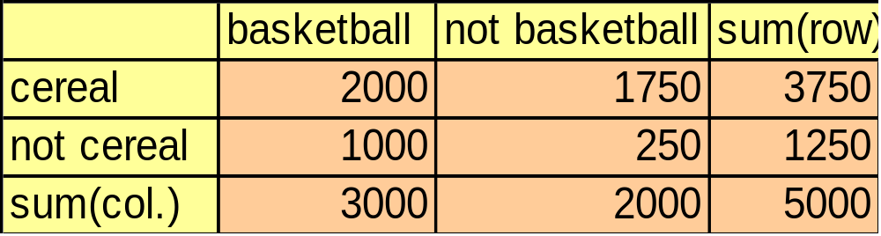
Criticism to Support and Confidence
Example 1: (Aggarwal & Yu, PODS98)
  Among 5000 students
    3000 play basketball
    3750 eat cereal
    2000 both play basket ball and eat cereal
  play basketball ⇒ eat cereal [40%, 66.7%] is misleading because the overall percentage of students eating cereal is 75% which is higher than 66.7%.
  play basketball ⇒ not eat cereal [20%, 33.3%] is far more accurate, although with lower support and confidence
Data Mining: Concepts and Techniques

Slide 65
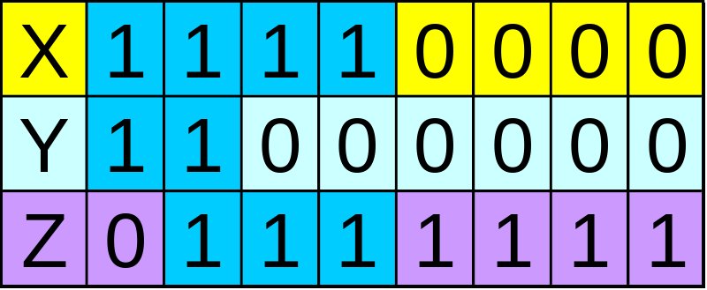
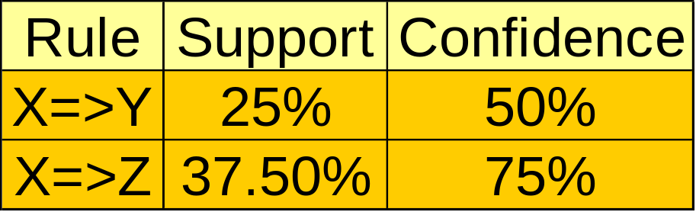
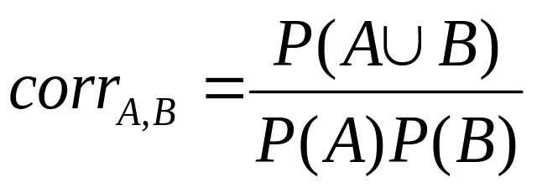
Criticism to Support and Confidence (Cont.)
Example 2:
  X and Y: positively correlated,
  X and Z, negatively related
  support and confidence of
  X=>Z dominates
We need a measure of dependent or correlated events
P(B|A)/P(B) is also called the lift of rule A => B
Data Mining: Concepts and Techniques

Slide 66
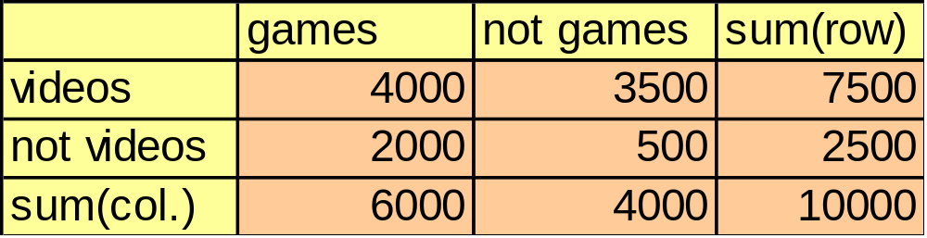
Association analysis to Correlation analysis
  Among 10000 purchase of computer games and videos
    6000 computer games purchased
    7500 videos purchased
    4000 both computer games and videos purchased
  Rule buys (games) ⇒ buys(videos) [40%, 66.7%] is strong association rule as the support and confidence value are higher than minimum thresholds.
  But buys (games) ⇒ buys(videos) [40%, 66.7%] is misleading because the overall percentage of purchasing videos is 75% which is higher than 66.7%.
  To tackle this weakness, correlation measures are used.
Data Mining: Concepts and Techniques

Slide 67
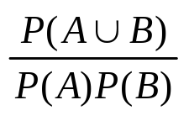
Correlation Measures : lift
The occurrence of item set A is independent of the occurrence of item set B if P(A∪B)=P(A)P(B) otherwise item set A and B are dependent and correlated.
Lift : lift(A,B)=
If the resulting value is less than 1, then A and B are negatively correlated i.e. occurrence of one leads to absence of other one.
If the resulting value is greater than 1, then A and B are positively correlated i.e occurrence of one implies the occurrence of the other one.
If the resulting value is equal to 1, then A and B are independent and there is no correlation between them.
Data Mining: Concepts and Techniques

Slide 68
Correlation Measures : lift
To filter out misleading strong association of rule buys (games) ⇒ buys(videos) [40%, 66.7%]
Probability of purchasing
  games is P(games)=6000/10000=0.60
  videos is P(videos)=7500/10000=0.75
  both is P(games,videos)=4000/10000=0.40
The lift of above rule is P(games,videos)/(P(games)XP(videos))=0.40/(0.60X0.75)=0.89The value is less than 1, there is negative correlation between games and videos.
Data Mining: Concepts and Techniques

Slide 69
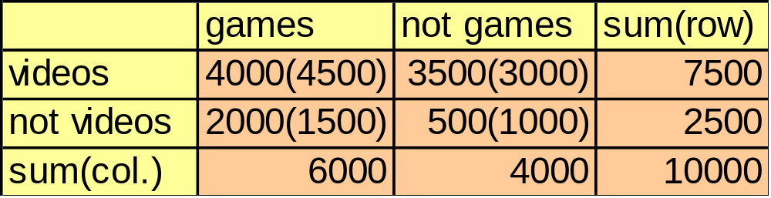
Correlation Measures : χ²
The χ² value is calculated as sum for all the slots of the table, of the squared difference between observed and expected value for a slot (A & B) in the table, divided by the expected value of same slot.
The expected value are displayed in parenthesis.
The value is =Σ (observed-expected)²/expected
= (4000-4500)²/4500 + (3500-3000)²/3000+
(2000-1500)²/1500+ (500-1000)²/1000
= 555.6
χ² value is greater than 1 and observed value of (game, video) is 4000 which is less than the expected value of 4500 so games and videos are negatively correlated.
Data Mining: Concepts and Techniques

Slide 70
Concept Description, Mining Frequent Patterns, Associations and Correlations
What is concept description?
Data generalization and summarization-based characterization
Analytical characterization: Analysis of attribute relevance
Mining class comparisons: Discriminating between different classes
Association rule mining
Mining single-dimensional Boolean association rules from transactional databases
Mining multilevel association rules from transactional databases
Mining multidimensional association rules from transactional databases and data warehouse
From association mining to correlation analysis
Constraint-based association mining
Summary
Data Mining: Concepts and Techniques

Slide 71
Constraint-Based Mining
Interactive, exploratory mining giga-bytes of data?
  Could it be real? — Making good use of constraints!
What kinds of constraints can be used in mining?
  Knowledge type constraint: classification, association, etc.
  Data constraint: SQL-like queries
    Find product pairs sold together in Vancouver in Dec.’98.
  Dimension/level constraints:
    in relevance to region, price, brand, customer category.
  Rule constraints
    small sales (price < $10) triggers big sales (sum > $200).
  Interestingness constraints:
    strong rules (min_support ≥ 3%, min_confidence ≥ 60%).
Data Mining: Concepts and Techniques

Slide 72
Rule Constraints in Association Mining
Two kind of rule constraints:
  Rule form constraints: meta-rule guided mining.
    P(x, y) ^ Q(x, w) → takes(x, “database systems”).
  Rule (content) constraint: constraint-based query optimization (Ng, et al., SIGMOD’98).
    sum(LHS) < 100 ^ min(LHS) > 20 ^ count(LHS) > 3 ^ sum(RHS) > 1000
1-variable vs. 2-variable constraints (Lakshmanan, et al. SIGMOD’99):
  1-var: A constraint confining only one side (L/R) of the rule, e.g., as shown above.
  2-var: A constraint confining both sides (L and R).
    sum(LHS) < min(RHS) ^ max(RHS) < 5* sum(LHS)
Data Mining: Concepts and Techniques

Slide 73
Constrain-Based Association Query
Database: (1) trans (TID, Itemset ), (2) itemInfo (Item, Type, Price)
A constrained asso. query (CAQ) is in the form of {(S1, S2 )|C },
  where C is a set of constraints on S1, S2 including frequency constraint
A classification of (single-variable) constraints:
  Class constraint: S ⊂ A. e.g. S ⊂ Item
  Domain constraint:
    Sθ v, θ ∈ { =, ≠, <, ≤, >, ≥ }. e.g. S.Price < 100
    vθ S, θ is ∈ or ∉. e.g. snacks ∉ S.Type
    Vθ S, or Sθ V, θ ∈ { ⊆, ⊂, ⊄, =, ≠ }
      e.g. {snacks, sodas } ⊆ S.Type
  Aggregation constraint: agg(S) θ v, where agg is in {min, max, sum, count, avg}, and θ ∈ { =, ≠, <, ≤, >, ≥ }.
    e.g. count(S1.Type) = 1 , avg(S2.Price) < 100
Data Mining: Concepts and Techniques

Slide 74
Constrained Association Query Optimization Problem
Given a CAQ = { (S1, S2) | C }, the algorithm should be :
  sound: It only finds frequent sets that satisfy the given constraints C
  complete: All frequent sets satisfy the given constraints C are found
A naïve solution:
  Apply Apriori for finding all frequent sets, and then to test them for constraint satisfaction one by one.
Our approach:
  Comprehensive analysis of the properties of constraints and try to push them as deeply as possible inside the frequent set computation.
Data Mining: Concepts and Techniques

Slide 75
Anti-monotone and Monotone Constraints
A constraint C_{a} is anti-monotone iff. for any pattern S not satisfying C_{a}, none of the super-patterns of S can satisfy C_{a}
A constraint C_{m} is monotone iff. for any pattern S satisfying C_{m}, every super-pattern of S also satisfies it
Data Mining: Concepts and Techniques

Slide 76
Succinct Constraint
A subset of item I_{s} is a succinct set, if it can be expressed as σ_{p}(I) for some selection predicate p, where σ is a selection operator
SP⊆2^{I} is a succinct power set, if there is a fixed number of succinct set I₁, …, I_{k} ⊆I, s.t. SP can be expressed in terms of the strict power sets of I₁, …, I_{k} using union and minus
A constraint C_{s} is succinct provided SAT_{Cs}(I) is a succinct power set
Data Mining: Concepts and Techniques

Slide 77
Convertible Constraint
Suppose all items in patterns are listed in a total order R
A constraint C is convertible anti-monotone iff a pattern S satisfying the constraint implies that each suffix of S w.r.t. R also satisfies C
A constraint C is convertible monotone iff a pattern S satisfying the constraint implies that each pattern of which S is a suffix w.r.t. R also satisfies C
Data Mining: Concepts and Techniques

Slide 78
Relationships Among Categories of Constraints
Succinctness
Anti-monotonicity
Monotonicity
Convertible constraints
Inconvertible constraints
Data Mining: Concepts and Techniques

Slide 79
Property of Constraints: Anti-Monotone
Anti-monotonicity: If a set S violates the constraint, any superset of S violates the constraint.
Examples:
  sum(S.Price) ≤ v is anti-monotone
  sum(S.Price) ≥ v is not anti-monotone
  sum(S.Price) = v is partly anti-monotone
Application:
  Push “sum(S.price) ≤ 1000” deeply into iterative frequent set computation.
Data Mining: Concepts and Techniques

Slide 80
Characterization of
Anti-Monotonicity Constraints
S θ v, θ ∈ { =, ≤, ≥ }
v ∈ S
S ⊇ V
S ⊆ V
S = V
min(S) ≤ v
min(S) ≥ v
min(S) = v
max(S) ≤ v
max(S) ≥ v
max(S) = v
count(S) ≤ v
count(S) ≥ v
count(S) = v
sum(S) ≤ v
sum(S) ≥ v
sum(S) = v
avg(S) θ v, θ ∈ { =, ≤, ≥ }
(frequent constraint)
yes
no
no
yes
partly
no
yes
partly
yes
no
partly
yes
no
partly
yes
no
partly
convertible
(yes)
Data Mining: Concepts and Techniques

Slide 81
Example of Convertible Constraints: Avg(S) θ V
Let R be the value descending order over the set of items
  E.g. I={9, 8, 6, 4, 3, 1}
Avg(S) ≥ v is convertible monotone w.r.t. R
  If S is a suffix of S₁, avg(S₁) ≥ avg(S)
    {8, 4, 3} is a suffix of {9, 8, 4, 3}
    avg({9, 8, 4, 3})=6 ≥ avg({8, 4, 3})=5
  If S satisfies avg(S) ≥v, so does S₁
    {8, 4, 3} satisfies constraint avg(S) ≥ 4, so does {9, 8, 4, 3}
Data Mining: Concepts and Techniques

Slide 82
Property of Constraints: Succinctness
Succinctness:
  For any set S1 and S2 satisfying C, S1 ∪ S2 satisfies C
  Given A1 is the sets of size 1 satisfying C, then any set S satisfying C are based on A1 , i.e., it contains a subset belongs to A1 ,
Example :
  sum(S.Price ) ≥ v is not succinct
  min(S.Price ) ≤ v is succinct
Optimization:
  If C is succinct, then C is pre-counting prunable. The satisfaction of the constraint alone is not affected by the iterative support counting.
Data Mining: Concepts and Techniques

Slide 83
Characterization of Constraints by Succinctness
S θ v, θ ∈ { =, ≤, ≥ }
v ∈ S
S ⊇V
S ⊆ V
S = V
min(S) ≤ v
min(S) ≥ v
min(S) = v
max(S) ≤ v
max(S) ≥ v
max(S) = v
count(S) ≤ v
count(S) ≥ v
count(S) = v
sum(S) ≤ v
sum(S) ≥ v
sum(S) = v
avg(S) θ v, θ ∈ { =, ≤, ≥ }
(frequent constraint)
Yes
yes
yes
yes
yes
yes
yes
yes
yes
yes
yes
weakly
weakly
weakly
no
no
no
no
(no)
Data Mining: Concepts and Techniques

Slide 84
Why Is the Big Pie Still There?
More on constraint-based mining of associations
  Boolean vs. quantitative associations
    Association on discrete vs. continuous data
  From association to correlation and causal structure analysis.
    Association does not necessarily imply correlation or causal relationships
  From intra-trasanction association to inter-transaction associations
    E.g., break the barriers of transactions (Lu, et al. TOIS’99).
  From association analysis to classification and clustering analysis
    E.g, clustering association rules
Data Mining: Concepts and Techniques

Slide 85
Concept Description, Mining Frequent Patterns, Associations and Correlations
What is concept description?
Data generalization and summarization-based characterization
Analytical characterization: Analysis of attribute relevance
Mining class comparisons: Discriminating between different classes
Association rule mining
Mining single-dimensional Boolean association rules from transactional databases
Mining multilevel association rules from transactional databases
Mining multidimensional association rules from transactional databases and data warehouse
From association mining to correlation analysis
Constraint-based association mining
Summary
Data Mining: Concepts and Techniques

Slide 86
Summary
Association rule mining
  probably the most significant contribution from the database community in KDD
  A large number of papers have been published
Many interesting issues have been explored
An interesting research direction
  Association analysis in other types of data: spatial data, multimedia data, time series data, etc.
Data Mining: Concepts and Techniques

Slide 87
References
R. Agarwal, C. Aggarwal, and V. V. V. Prasad. A tree projection algorithm for generation of frequent itemsets. In Journal of Parallel and Distributed Computing (Special Issue on High Performance Data Mining), 2000.
R. Agrawal, T. Imielinski, and A. Swami. Mining association rules between sets of items in large databases. SIGMOD'93, 207-216, Washington, D.C.
R. Agrawal and R. Srikant. Fast algorithms for mining association rules. VLDB'94 487-499, Santiago, Chile.
R. Agrawal and R. Srikant. Mining sequential patterns. ICDE'95, 3-14, Taipei, Taiwan.
R. J. Bayardo. Efficiently mining long patterns from databases. SIGMOD'98, 85-93, Seattle, Washington.
S. Brin, R. Motwani, and C. Silverstein. Beyond market basket: Generalizing association rules to correlations. SIGMOD'97, 265-276, Tucson, Arizona.
S. Brin, R. Motwani, J. D. Ullman, and S. Tsur. Dynamic itemset counting and implication rules for market basket analysis. SIGMOD'97, 255-264, Tucson, Arizona, May 1997.
K. Beyer and R. Ramakrishnan. Bottom-up computation of sparse and iceberg cubes. SIGMOD'99, 359-370, Philadelphia, PA, June 1999.
D.W. Cheung, J. Han, V. Ng, and C.Y. Wong. Maintenance of discovered association rules in large databases: An incremental updating technique. ICDE'96, 106-114, New Orleans, LA.
M. Fang, N. Shivakumar, H. Garcia-Molina, R. Motwani, and J. D. Ullman. Computing iceberg queries efficiently. VLDB'98, 299-310, New York, NY, Aug. 1998.
Data Mining: Concepts and Techniques

Slide 88
References (2)
G. Grahne, L. Lakshmanan, and X. Wang. Efficient mining of constrained correlated sets. ICDE'00, 512-521, San Diego, CA, Feb. 2000.
Y. Fu and J. Han. Meta-rule-guided mining of association rules in relational databases. KDOOD'95, 39-46, Singapore, Dec. 1995.
T. Fukuda, Y. Morimoto, S. Morishita, and T. Tokuyama. Data mining using two-dimensional optimized association rules: Scheme, algorithms, and visualization. SIGMOD'96, 13-23, Montreal, Canada.
E.-H. Han, G. Karypis, and V. Kumar. Scalable parallel data mining for association rules. SIGMOD'97, 277-288, Tucson, Arizona.
J. Han, G. Dong, and Y. Yin. Efficient mining of partial periodic patterns in time series database. ICDE'99, Sydney, Australia.
J. Han and Y. Fu. Discovery of multiple-level association rules from large databases. VLDB'95, 420-431, Zurich, Switzerland.
J. Han, J. Pei, and Y. Yin. Mining frequent patterns without candidate generation. SIGMOD'00, 1-12, Dallas, TX, May 2000.
T. Imielinski and H. Mannila. A database perspective on knowledge discovery. Communications of ACM, 39:58-64, 1996.
M. Kamber, J. Han, and J. Y. Chiang. Metarule-guided mining of multi-dimensional association rules using data cubes. KDD'97, 207-210, Newport Beach, California.
M. Klemettinen, H. Mannila, P. Ronkainen, H. Toivonen, and A.I. Verkamo. Finding interesting rules from large sets of discovered association rules. CIKM'94, 401-408, Gaithersburg, Maryland.
Data Mining: Concepts and Techniques

Slide 89
References (3)
F. Korn, A. Labrinidis, Y. Kotidis, and C. Faloutsos. Ratio rules: A new paradigm for fast, quantifiable data mining. VLDB'98, 582-593, New York, NY.
B. Lent, A. Swami, and J. Widom. Clustering association rules. ICDE'97, 220-231, Birmingham, England.
H. Lu, J. Han, and L. Feng. Stock movement and n-dimensional inter-transaction association rules. SIGMOD Workshop on Research Issues on Data Mining and Knowledge Discovery (DMKD'98), 12:1-12:7, Seattle, Washington.
H. Mannila, H. Toivonen, and A. I. Verkamo. Efficient algorithms for discovering association rules. KDD'94, 181-192, Seattle, WA, July 1994.
H. Mannila, H Toivonen, and A. I. Verkamo. Discovery of frequent episodes in event sequences. Data Mining and Knowledge Discovery, 1:259-289, 1997.
R. Meo, G. Psaila, and S. Ceri. A new SQL-like operator for mining association rules. VLDB'96, 122-133, Bombay, India.
R.J. Miller and Y. Yang. Association rules over interval data. SIGMOD'97, 452-461, Tucson, Arizona.
R. Ng, L. V. S. Lakshmanan, J. Han, and A. Pang. Exploratory mining and pruning optimizations of constrained associations rules. SIGMOD'98, 13-24, Seattle, Washington.
N. Pasquier, Y. Bastide, R. Taouil, and L. Lakhal. Discovering frequent closed itemsets for association rules. ICDT'99, 398-416, Jerusalem, Israel, Jan. 1999.
Data Mining: Concepts and Techniques

Slide 90
References (4)
J.S. Park, M.S. Chen, and P.S. Yu. An effective hash-based algorithm for mining association rules. SIGMOD'95, 175-186, San Jose, CA, May 1995.
J. Pei, J. Han, and R. Mao. CLOSET: An Efficient Algorithm for Mining Frequent Closed Itemsets. DMKD'00, Dallas, TX, 11-20, May 2000.
J. Pei and J. Han. Can We Push More Constraints into Frequent Pattern Mining? KDD'00. Boston, MA. Aug. 2000.
G. Piatetsky-Shapiro. Discovery, analysis, and presentation of strong rules. In G. Piatetsky-Shapiro and W. J. Frawley, editors, Knowledge Discovery in Databases, 229-238. AAAI/MIT Press, 1991.
B. Ozden, S. Ramaswamy, and A. Silberschatz. Cyclic association rules. ICDE'98, 412-421, Orlando, FL.
J.S. Park, M.S. Chen, and P.S. Yu. An effective hash-based algorithm for mining association rules. SIGMOD'95, 175-186, San Jose, CA.
S. Ramaswamy, S. Mahajan, and A. Silberschatz. On the discovery of interesting patterns in association rules. VLDB'98, 368-379, New York, NY..
S. Sarawagi, S. Thomas, and R. Agrawal. Integrating association rule mining with relational database systems: Alternatives and implications. SIGMOD'98, 343-354, Seattle, WA.
A. Savasere, E. Omiecinski, and S. Navathe. An efficient algorithm for mining association rules in large databases. VLDB'95, 432-443, Zurich, Switzerland.
A. Savasere, E. Omiecinski, and S. Navathe. Mining for strong negative associations in a large database of customer transactions. ICDE'98, 494-502, Orlando, FL, Feb. 1998.
Data Mining: Concepts and Techniques

Slide 91
References (5)
C. Silverstein, S. Brin, R. Motwani, and J. Ullman. Scalable techniques for mining causal structures. VLDB'98, 594-605, New York, NY.
R. Srikant and R. Agrawal. Mining generalized association rules. VLDB'95, 407-419, Zurich, Switzerland, Sept. 1995.
R. Srikant and R. Agrawal. Mining quantitative association rules in large relational tables. SIGMOD'96, 1-12, Montreal, Canada.
R. Srikant, Q. Vu, and R. Agrawal. Mining association rules with item constraints. KDD'97, 67-73, Newport Beach, California.
H. Toivonen. Sampling large databases for association rules. VLDB'96, 134-145, Bombay, India, Sept. 1996.
D. Tsur, J. D. Ullman, S. Abitboul, C. Clifton, R. Motwani, and S. Nestorov. Query flocks: A generalization of association-rule mining. SIGMOD'98, 1-12, Seattle, Washington.
K. Yoda, T. Fukuda, Y. Morimoto, S. Morishita, and T. Tokuyama. Computing optimized rectilinear regions for association rules. KDD'97, 96-103, Newport Beach, CA, Aug. 1997.
M. J. Zaki, S. Parthasarathy, M. Ogihara, and W. Li. Parallel algorithm for discovery of association rules. Data Mining and Knowledge Discovery, 1:343-374, 1997.
M. Zaki. Generating Non-Redundant Association Rules. KDD'00. Boston, MA. Aug. 2000.
O. R. Zaiane, J. Han, and H. Zhu. Mining Recurrent Items in Multimedia with Progressive Resolution Refinement. ICDE'00, 461-470, San Diego, CA, Feb. 2000.
Data Mining: Concepts and Techniques

Slide 92

http://www.cs.sfu.ca/~han/dmbook
Thank you !!!
Data Mining: Concepts and Techniques

